Slide 1
MDS and Cluster Analysis
Using the 2012 County Health Ranking Minnesota Data
Andrew Lundborg
Allison Chock

Slide 2
Variables Used
Community Safety
Family and Social Support
Quality of Care
Access to Care
Environmental Quality
*Kittson, Lake of the Woods, and Traverse counties were omitted from the data set because of missing data

Slide 3
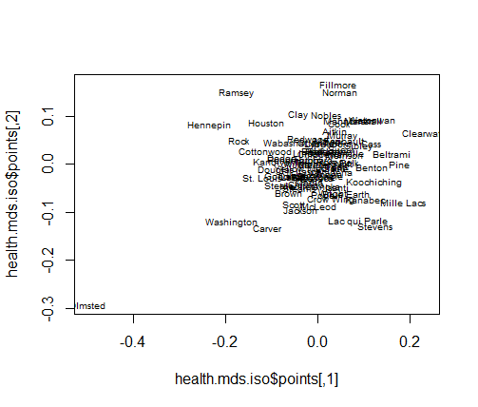
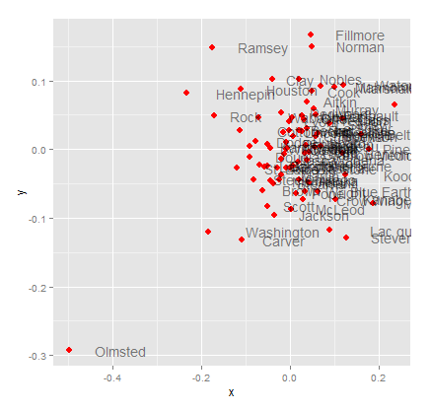
Non-metric MDS

Slide 4
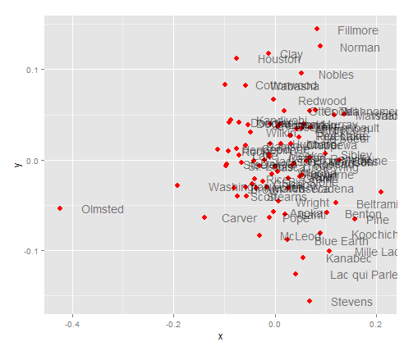
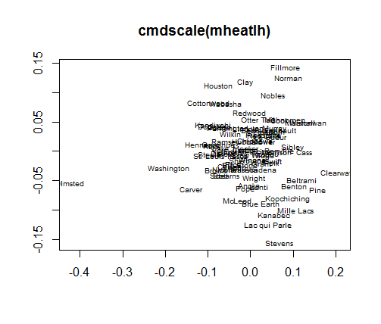
Metric MDS

Slide 5
Interpretation of MDS
Dissimilarity matrix used
Non-Metric MDS is more compact
Metric MDS is further spread out
Most counties cluster around the origin
Olmsted is the most dissimilar of all the counties
Norman, Clay, Fillmore, Houston, and Nobles are most unlike Stevens, Kanabec, Lac qui Parle, and Mille Lacs
The further apart the counties are from one another, the more unlike they will be in terms of our selected variables.

Slide 6
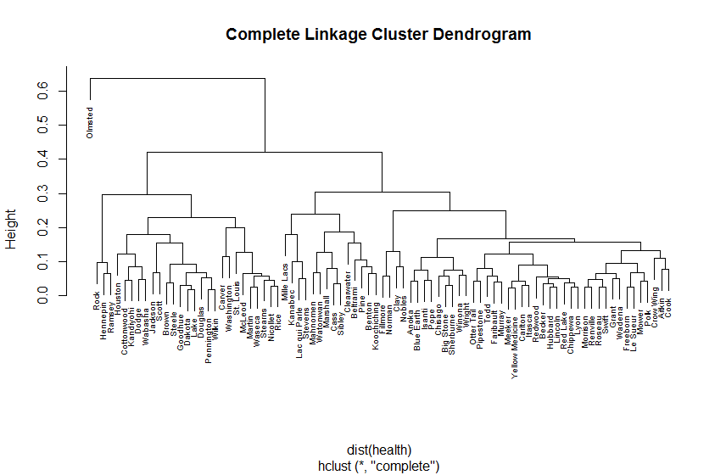
Cluster Analysis

Slide 7
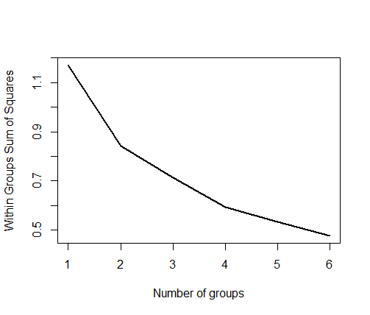
Interpretation of Cluster Analysis
Scree plot indicates 4 clusters will be adequate
Olmsted will be its own cluster
Cluster 2: second largest with 27 counties; mostly southern and metropolitan counties
Cluster 3: second smallest with 14 counties; west and east central counties, north west counties
Cluster 4: largest with 45 counties; central counties, random counties throughout the rest of the state
The third and fourth clusters contain random counties throughout the state; understandable since they are joined together

